Slide 1

In case of using ATM cards
Fraud Detection

Slide 2

Fraud Detection via Video Analysis
Cash withdrawal without notice of a person.
Usage of cards online at ecommerce by third party/hacker.
Issue with card at ATM and seeking for immediate help.

Slide 3

Prevention rather than solution for 1st and 2nd Problem statement

Slide 4
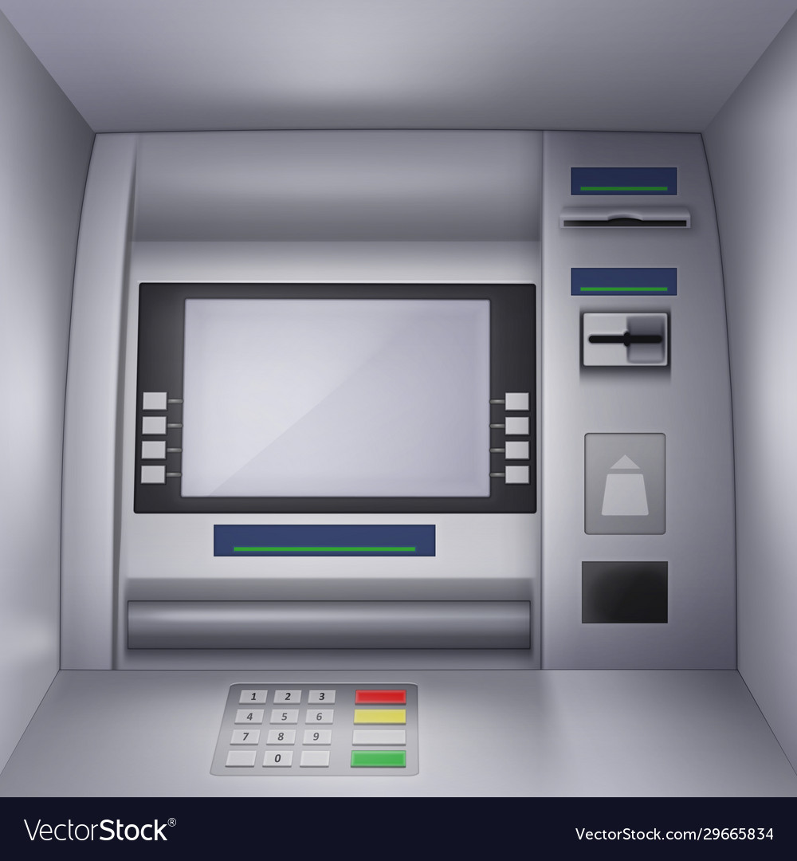
Idea – Transaction Security
Have a login and logout time at ATM along with a photo identity for every individual.
Suggestion – Unless machine could identify the person from social database, he cannot proceed further with transaction
Camera fixed to machine
Automatically notes login and logout time on card insertion.
Possibilities on spending more time at ATM –
Withdrawing huge amount by inserting card for multiple times.
Facing technical issue with machine (machine couldn’t read the card, touch screen not working properly, no efficient amount in the machine)
Fraud trying to use an ATM card.

Slide 5

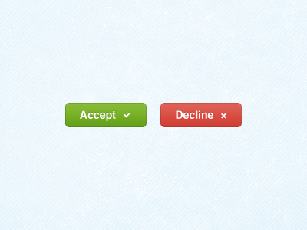
Idea - Transaction Security
Give access to owner of the card on transaction proceeding.
In this way, we can reduce the fraud happening at ATM. And if any fraud occurs, we can also track the person
who has done it by making photo verification compulsory at all ATMs
Information (person photo, login and logout time) on card usage is sent to the owner of the card.
Provide authority to user via app on allowing or denying the transaction at the moment. If the person couldn’t take action in the given time, then transaction will be done and later details will be sent to the owner.

Slide 6
Solution for 3rd Problem statement

Slide 7
Idea – Help with the Glitch
Sometimes, many of us face some technical issue with ATM Machine.
Urgency of penny but ATM doesn’t have amount in it.
There is a technical glitch in the machine where it couldn’t accept or read the card.
The touch screen of the ATM doesn’t work properly.
In case of all above three, solution is - We go to next ATM, but
Q1. What if we are new to place and don’t know where is the next ATM nearby?
Q2. How will the Authority know that there is an issue/kind of issue with the ATM?
Q3. How next user know that there is problem with this particular ATM before he steps into it?

Slide 8
Idea – Help with the Glitch
Have a report option on the machine so that authority knows if there is any technical glitch.
Have some buttons as providing the feedback of machine working status in ATM. Based on the feedback, the working status of machine can be indicated.
Have the next nearby ATM details which works fine(status of machines can be interlinked) in the present machine.
Suggestion –
People who are new to ATM and not aware of withdrawing the amount can be helped by providing a video/instructions on how to make transactions in ATM.
Video or instructions can be displayed on the screen itself before transaction happens.
Working status
No glitches
Has an issue

Slide 9

Thank You
Lavanya Pasunoori
+91 9052237153
Hyderabad, India

